Slide 1
Statistical harmonization corrects site effects in functional connectivity measurements from multi-site fMRI data
Jingwei Li
Notes:
Today I will talk about a paper trying to eliminate site effects for fMRI data.

Slide 2
Collect data from multiple sites
Rapidly recruit more subjects, increase statistical power
e.g. rare disorder, generalization to diverse population
Introduce non-biological variability across sites/scanners.
Variability not eliminated completely by standardization of acquisition parameters.
Methods to remove site effects are needed.
Notes:
Collecting data from multiple sites enables investigators to recruit more participants and hence can improve the statistical power. It is especially useful when the aim is to study some disease that happens rarely in the population, or trying to make the results generalized to diverse population.

Slide 3
Collect data from multiple sites
Rapidly recruit more subjects, increase statistical power
e.g. rare disorder, generalization to diverse population
Introduce non-biological variability across sites/scanners.
Variability not eliminated completely by standardization of acquisition parameters.
Methods to remove site effects are needed.
Notes:
But it can also lead to a problem that data from difference site may not be comparable. Some non-biological variability related to scanners or sites can be introduced into the data.

Slide 4
Collect data from multiple sites
Rapidly recruit more subjects, increase statistical power
e.g. rare disorder, generalization to diverse population
Introduce non-biological variability across sites/scanners.
Variability not eliminated completely by standardization of acquisition parameters.
Methods to remove site effects are needed.
Notes:
And this non-biological variability cannot be completely eliminated even if the acquisition parameters are harmonized in prior.

Slide 5
Collect data from multiple sites
Rapidly recruit more subjects, increase statistical power
e.g. rare disorder, generalization to diverse population
Introduce non-biological variability across sites/scanners.
Variability not eliminated completely by standardization of acquisition parameters.
Methods to remove site effects are needed.
Notes:
Hence we need a method to remove site effects in the collected data.

Slide 6
Two main objectives of this paper
Whether the method they used (ComBat; Johnson2007) can remove site effects in functional connectivity?
Under 2 FC metrics x 3 parcellations
FC metrics: Pearson’s r, wavelet coherence
Parcellations: AAL, Power2011, Gordon2016
Does ComBat preserve negative correlation between age and network metrics?
Network metrics: DMN network connectivity, DMN nodel strength, weighted DMN local efficiency, weighted global efficiency.
Notes:
There are two main objectives in this paper. Firstly, they want to study if a method called ComBat can remove site effects in functional connectivity. ComBat method was proposed in a genomic study to remove variability in genomic data collected from different labs. In this paper, they replace the genomic data with functional connectivity data. To check if this method depends on different parcellations or different approaches to compute functional connectivity, they did the same analyses with 2 types of FC measures and 3 parcellations.

Slide 7
Two main objectives of this paper
Whether the method they used (ComBat; Johnson2007) can remove site effects in functional connectivity?
Under 2 FC metrics x 3 parcellations
FC metrics: Pearson’s r, wavelet coherence
Parcellations: AAL, Power2011, Gordon2016
Does ComBat preserve negative correlation between age and network metrics?
Network metrics: DMN network connectivity, DMN nodel strength, weighted DMN local efficiency, weighted global efficiency.
Notes:
The second objective of this study is to see whether ComBat preserve negative correlation between age and some FC-based network measures. They utilized 4 types of network measures. I will introduce them later.

Slide 8
Datasets
Subjects
228 subjects: 189 MDD (major depressive disorder) + 39 healthy
age: 18-65
4 sites: CU (Columbia University), MGH, TX (Texas Southwestern Medical Center), UM (University of Michigan)
harmonized across sites before data collection
fMRI Preprocessing
Deconfounding: 36 regressors (6 motion + GS + WM + CSF, derivative, quadratic term, derivative of quadratic term)
Alignment to a population-specific template
Bandpass filtering: 0.01-0.08Hz
Smooth: 6mm FWHM
Notes:
They used a dataset with more than 200 subjects, including 189 MDD patients and 39 healthy subjects. The age range is large, from 18 to 65. There are 4 sites in this datasets, and the acquisition parameters were harmonized before data collection.

Slide 9
Datasets
Subjects
228 subjects: 189 MDD (major depressive disorder) + 39 healthy
age: 18-65
4 sites: CU (Columbia University), MGH, TX (Texas Southwestern Medical Center), UM (University of Michigan)
harmonized across sites before data collection
fMRI Preprocessing
Deconfounding: 36 regressors (6 motion + GS + WM + CSF, derivative, quadratic term, derivative of quadratic term)
Alignment to a population-specific template
Bandpass filtering: 0.01-0.08Hz
Smooth: 6mm FWHM
Notes:
For preprocessing, they regressed out 36 regressors including global signal. And they registered the data into a common template, did bandpass filtering and smoothing.

Slide 10
Parcellations & FC metrics
Parcellations
AAL: 90 ROIs
Power: 203 ROIs after removing ROIs with poor signal quality
Gordon: 307 ROIs after removing ROIs with poor signal quality
FC metrics
Pearson’s r: Fisher’s z transformed
Wavelet Coherence
Wavelets: characteristics of signal in time-frequency domain
How similar are the wavelets of two signals
Notes:
The 3 parcellations they used are AAL, Power, and Gordon. For Power’s and Gordon’s parcellations, they removed some ROIs with poor signal quality, resulting in 203 ROIs and 307 ROIs respectively.

Slide 11
Parcellations & FC metrics
Parcellations
AAL: 90 ROIs
Power: 203 ROIs after removing ROIs with poor signal quality
Gordon: 307 ROIs after removing ROIs with poor signal quality
FC metrics
Pearson’s r: Fisher’s z transformed
Wavelet Coherence
Wavelets: characteristics of signal in time-frequency domain
How similar are the wavelets of two signals
Notes:
The methods to calculate functional connectivity are Pearson’s correlation and wavelet coherence. Basically, wavelets are some characteristics of a signal in time-frequency domain. and wavelet coherence captures how similar are the wavelets of two signals.

Slide 12
Wavelet Coherence
$$R_{n}^{2}\left(s\right)=\frac{{\left|S\left(s^{−1}W_{N}^{XY}\left(s\right)\right)\right|}^{2}}{S\left(s^{−1}{\left|W_{n}^{X}\left(s\right)\right|}^{2}\right)∗S\left(s^{−1}{\left|W_{n}^{Y}\left(s\right)\right|}^{2}\right)}$$
$S$ is a smoothing operator, in time and frequency
$W^{X}$, $W^{Y}$ are the wavelets for time series $X$ and $Y$
$W^{XY}$ is the cross wavelet $=W^{X}W^{Y∗}$ ($∗$ means complex conjugate)
$s$ = scale, $n$ = time index

Slide 13
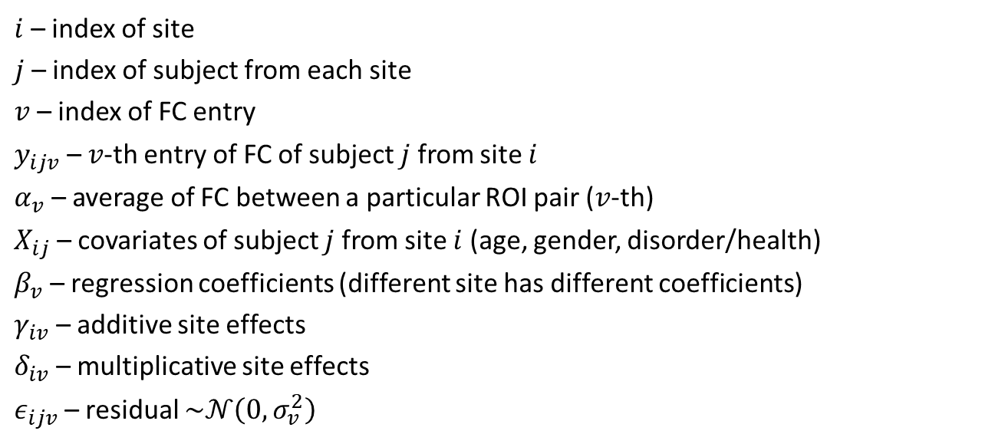
ComBat – model site effects
$$y_{ijv}=α_{v}+X_{ij}^{T}β_{v}+γ_{iv}+δ_{iv}ε_{ijv}$$
$i$ – index of site
$j$ – index of subject from each site
$v$ – index of FC entry
$y_{ijv}$ – $v$-th entry of FC of subject $j$ from site $i$
$α_{v}$ – average of FC between a particular ROI pair ($v$-th)
$X_{ij}$ – covariates of subject $j$ from site $i$ (age, gender, disorder/health)
$β_{v}$ – regression coefficients (different site has different coefficients)
$γ_{iv}$ – additive site effects
$δ_{iv}$ – multiplicative site effects
$ε_{ijv}$ – residual $\sim 𝒩\left(0, σ_{v}^{2}\right)$
Notes:
The model the site effects is a mixed-effect model. i denotes …, j denotes …, v denotes … y_ijv denotes … It is represented by a combination of 4 terms. The 1st term alpha_v is … The 2nd term is fixed effects design matrix X multiples with its coefficients beta. In this paper they included age, gender and disorder group are covariates. The 3rd term gamma_iv is the additive site effects. The last term is the residual epsilon times the multiplicative site effects gamma. And the residual epsilon is assumed to follow a normal distribution with mean 0 and variance sigma_v^2.

Slide 14
ComBat – model site effects
$$y_{ijv}=α_{v}+X_{ij}^{T}β_{v}+γ_{iv}+δ_{iv}ε_{ijv}$$
FC after ComBat correction:
$y_{ijv}^{ComBat}=$ $\hat{α_{v}}+X_{ij}^{T}\hat{β_{v}}+\hat{ε_{ijv}}$
$$y_{ijv}^{ComBat}=\frac{y_{ijv}−\hat{α_{v}}−X_{ij}^{T}\hat{β_{v}}−γ_{iv}^{∗}}{δ_{iv}^{∗}}+\hat{α_{v}}+X_{ij}^{T}\hat{β_{v}}$$
$γ_{iv}^{∗}$ and $δ_{iv}^{∗}$ are estimated by empirical Bayes (EB) procedure.
Notes:
After all parameters in this model are estimated, the ComBat corrected FC is shown in the second equation. It is recovered by the average FC alpha, the fixed effects, and the residual. Both additive and multiplicative site effects are not included.

Slide 15
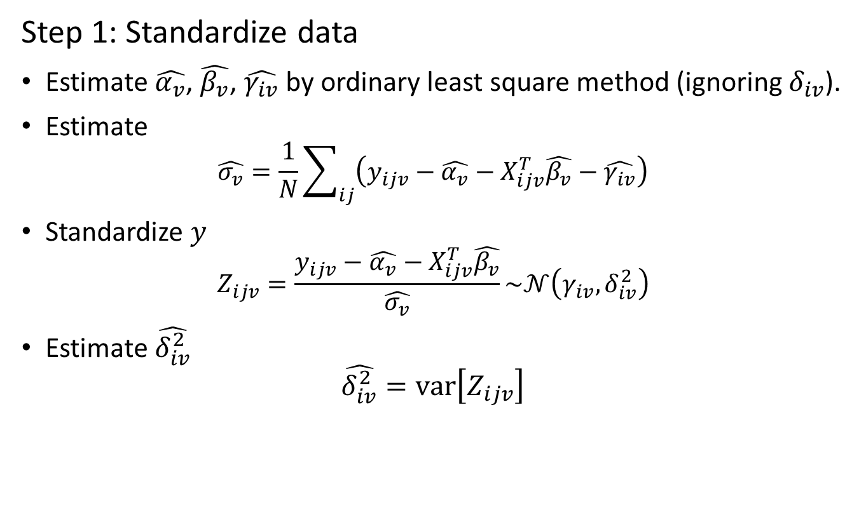
EB procedure of ComBat
Step 1: Standardize data
Estimate $\hat{α_{v}}$, $\hat{β_{v}}$, $\hat{γ_{iv}}$ by ordinary least square method (ignoring $δ_{iv}$).
Estimate
$$\hat{σ_{v}}=\frac{1}{N}\sum_{ij}{\left(y_{ijv}−\hat{α_{v}}−X_{ijv}^{T}\hat{β_{v}}−\hat{γ_{iv}}\right)}$$
Standardize $y$
$$Z_{ijv}=\frac{y_{ijv}−\hat{α_{v}}−X_{ijv}^{T}\hat{β_{v}}}{\hat{σ_{v}}}\sim 𝒩\left(γ_{iv}, δ_{iv}^{2}\right)$$
Estimate $\hat{δ_{iv}^{2}}$
$$\hat{δ_{iv}^{2}}=var\left[Z_{ijv}\right]$$
Notes:
Then we need to see how to estimate the parameters in this model. The first step is to standardize the data.
First, delta is ignored, and they estimate alpha^hat, beta^hat, gamma^hat by least square method.
Then sigma is estimated by the variance of the residual from least square results.
Then the standardized data Z is to use the original data minus intercept and fixed effects divided by sigma. It follows a normal distribution with mean gamma_iv and variance delta_iv^2. Delta_iv^2 is estimated as the variance of Z_ijv.

Slide 16
EB procedure of ComBat
Step 2: EB estimates of site-effect parameters
Assumption of conjugate priors
$$γ_{iv}\sim 𝒩\left(γ_{i}, τ_{i}^{2}\right), δ_{iv}^{2}\sim Inverse Gamma \left(λ_{i}, θ_{i}\right)$$
Use “method of moments” to estimate $γ_{i}$, $τ_{i}^{2}$, $λ_{i}$, $θ_{i}$
$$\overline{γ_{i}}=𝔼\left[γ_{iv}\right]=\frac{1}{V}\sum_{v}{\hat{γ_{iv}}}, \overline{τ_{i}^{2}}=var\left[γ_{iv}\right]=\frac{1}{V}{\sum_{v}{\left(\hat{γ_{iv}}−\frac{1}{V}\sum_{v}{\hat{γ_{iv}}}\right)}}^{2}$$
$$\overline{λ_{i}}=𝔼\left[δ_{iv}^{2}\right]=\frac{1}{V}\sum_{v}{\hat{δ_{iv}}}, \overline{θ_{i}}=var\left[δ_{iv}^{2}\right]=\frac{1}{V}\sum_{v}{{\left(\acute{δ_{iv}}−\frac{1}{V}\sum_{v}{\hat{δ_{iv}}}\right)}^{2}}$$
EB estimates of $γ_{iv}$, $δ_{iv}$
EB estimate of $γ_{iv}$= mean of posterior distribution of $γ_{iv}$
$$γ_{iv}^{∗}=\frac{1}{\frac{1}{\overline{τ_{i}^{2}}}+\frac{n_{i}}{{δ_{iv}^{2}}^{∗}}}\left(\frac{\overline{γ_{i}}}{\overline{τ_{i}^{2}}}+\frac{\sum_{j}{Z_{ijv}}}{{δ_{iv}^{2}}^{∗}}\right)=\frac{n_{i}\overline{τ_{i}^{2}}\hat{γ_{iv}}+{δ_{iv}^{2}}^{∗}\overline{γ_{i}}}{n_{i}\overline{τ_{i}^{2}}+{δ_{iv}^{2}}^{∗}}$$
EB estimate of $δ_{iv}$ obtained from parameters of posterior distribution of $δ_{iv}$
$$α^{′}=\overline{λ_{i}}+\frac{n_{i}}{2}, β^{′}=\overline{θ_{i}}+\frac{\sum_{j}{\left(Z_{ijv}−γ_{iv}^{∗}\right)}}{2}$$
$${δ_{iv}^{2}}^{∗}=\frac{\overline{θ_{i}}+\frac{\sum_{j}{{\left(Z_{ijv}−γ_{iv}^{∗}\right)}^{2}}}{2}}{\overline{λ_{i}}+\frac{n_{i}}{2}}$$
Parameters of posterior distribution
Notes:
Step 2 is to estimated site-effect parameters from empirical Bayes method.
It is assumed that gamma_iv has a prior of normal distribution with mean gamma_i and variance tau_i. Similarly, delta_iv is assumed to have a prior of inverse Gamma distribution with parameters of lambda_i and theta_i.
They used “method of moments” to estimate \gamma_i^bar, \tau_i^2^bar, \lambda_i^bar, and \theta_i^bar. Basically is just to compute the mean or variance of the corresponding variable.
Then to compute the empirical Bayes estimates of \gamma_iv, they used the mean of posterior distribution of \gamma_iv. It is a weighted sum of prior \gamma_i^bar, and the estimated \gamma_iv from step1.
Similarly, using the parameters of the posterior distribution of \delta_iv, they obtained the empirical Bayes estimate of delta_iv.
Since the estimate of \gamme_iv needs \delta_iv, and the estimate of delta_iv needs \gamma_iv, they iteratively solved the problem.

Slide 17
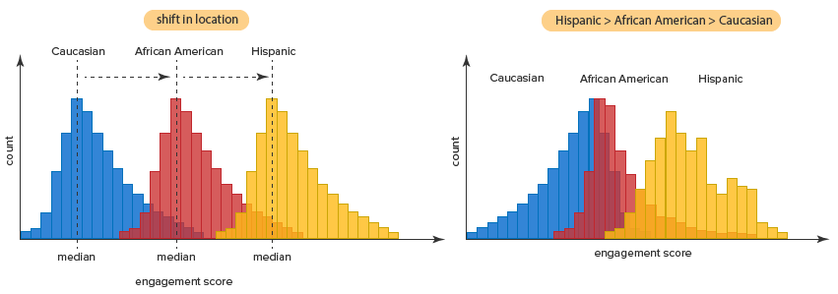
Test significance of site effects - Kruskal-Wallis test
Testing whether samples are from the same distribution
Assume distributions of all groups have the same shape
Same shape
Different shape
From Laerd Statistics website
Notes:
To test if there is site difference in the data, they used Kruskal-Wallis test. It tests whether the data from different groups are from the same distribution. The assumption is that the distributions of all groups have the same shape. Look at the pictures here, on the left, we say the 3 ditributions have the same shape, but on the right side, they are not in the same shape.

Slide 18
Test significance of site effects - Kruskal-Wallis test
Procedure
Rank all data from all groups
Test statistics: $H=\left(n−1\right)\frac{\sum_{i=1}^{g}{n_{i}{\left(\overline{r_{i ⋅}}−\overline{r}\right)}^{2}}}{\sum_{i=1}^{g}{\sum_{j=1}^{n_{i}}{{\left(r_{ij}−\overline{r}\right)}^{2}}}}$
$n_{i}$ – # observations in group $i$
$r_{ij}$ – rank of observation $j$ from group $i$
$n$ – total number of observations ($=\sum{n_{i}}$)
$\overline{r_{i⋅}}\text{–}$ average rank of all observations in group $i$ ($=\frac{\sum_{j}^{n_{i}}{r_{ij}}}{n_{i}}$)
$\overline{r}$ – average of all $r_{ij}$
$p=Pr\left(χ_{g−1}^{2}≥H\right)$
Notes:
For Kruskal-Wallis test, the first step is the rand all of your data. The second step is to compute the test statistics H. Basically H captures the differences of ranks across groups. And the p value is computed as the probability that a random variable following a chi-square distribution is greater than the test statistics.

Slide 19
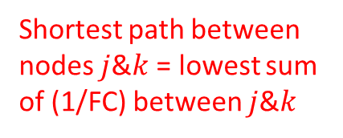
Network measures (used to test relationship with age)
DMN network connectivity
$$\frac{\sum{FC of ROI pairs within DMN}}{\#ROIs in DMN}$$
DMN nodal strength
$$\sum_{ROI∈DMN}{\left(\sum{FC between current ROI \& all other ROIs }\right)}$$
Weighted DMN local efficiency
$$E_{local}^{W}=\frac{1}{N_{G_{i}}\left(N_{G_{i}}−1\right)}\sum_{j,k∈G_{i}}{\frac{1}{L_{j,k}^{W}}}$$
Weighted global efficiency
$$E_{global}^{W}=\frac{1}{N\left(N−1\right)}\sum_{i≠j∈G}{\frac{1}{L_{i,j}^{W}}}$$
Shortest path between nodes $j$&$k$ = lowest sum of (1/FC) between $j$&$k$
#nodes in $G_{i}$
Neighboring nodes of node $i$ (excluding $i$)
#nodes in $G$
Set of all nodes
Notes:
To test the relationship between neuroimaging data and age, they used 4 network measures.
The first one is the default mode network connectivity. It is the summation of within DMN connectivity normalized by the number of ROIs in DMN.
The second one is the DMN nodal strength. It is computed by summing all strength of nodes in DMN. Strength of each node is the summation of all connectivity related to the current node.
DMN local efficiency is basically to first compute the local efficiency of one node and then sum over all nodes in DMN. The local efficiency of each node is computed as the summation of inverse shortest paths between two nodes that inside the neighboring of the current node.
Global efficiency is the summation of inverse shortest path between all possible pairs of nodes in the whole atlas.

Slide 20
Results – FC difference among sites were removed after ComBat
FC metric | Parcellation | # ROIs | Significant #edges before ComBat | Significant #edges after ComBat
Pearson correlation | AAL | 90 | 1610 (40.2%) | 0 (0%)
 | Power | 203 | 515 (2.5%) | 0 (0%)
 | Gordon | 307 | 603 (1.3%) | 0 (0%)
Wavelet Coherence | AAL | 90 | 7 (0.2%) | 0 (0%)
 | Power | 203 | 12 (0.06%) | 0 (0%)
 | Gordon | 307 | 17 (0.04%) | 0 (0%)
* p values were FDR corrected
Table 2.
Before ComBat, in all cases there were FC values significantly differed across sites. No significant site difference on FC values after ComBat.
AAL parcellation had more significant difference across sites than other 2 parcellations before ComBat.
More site effects when FC was measured by Pearson’s correlation before ComBat.
Notes:
Their first set of results showed that the FC differences across sites can be removed by ComBat.
This table is Table 2 from the paper. First column is the method to compute FC. Second column is the parcellation scheme. Third column is the number of ROIs in each parcellation. Forth column is the number of significant edges without ComBat. Fifth column is the number of significant edges after using ComBat.
Before …

Slide 21
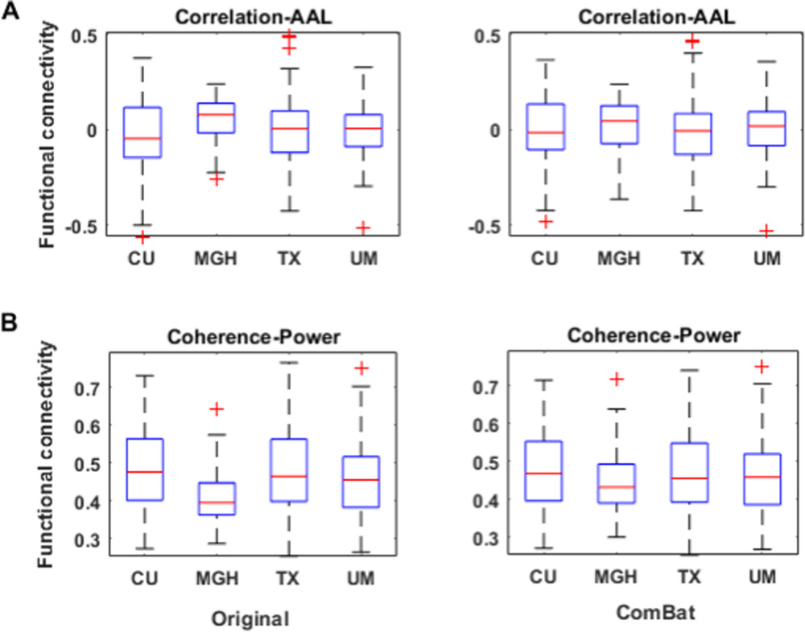
Results – FC difference among sites were removed after ComBat
FC medians of 4 sites were more different before ComBat than after ComBat. (especially for MGH)
Similar results for other combinations of FC metrics and parcellations.
Figure 2. Distributions of FC between 2 selected ROIs.
AAL: TPOmid.R (right temporal pole: middle temporal gyrus) & ACG.R (right anterior cingulate and paracingulate gyri)
Power: 2 regions in visual cortex
Notes:
Figure 2 in this paper showed the distribution of FC values between two selected ROIs respectively from AAL and Power parcellations. For AAL, they selected …; for Power, they selected two ROIs from visual cortex.
Panel A is the results with Pearson’s correlation and AAL parcellation; panel B is with wavelet coherence and Power’s parcellation.
On the left show the results without ComBat, and the right hand side is the result with ComBat. Each bar corresponds to one site. y-axis is the FC values between the two ROIs. Red line is the median of the distribution.
Here we can see the medians of FC of the 4 sites were more different without ComBat than after using ComBat, especially for MGH site.

Slide 22
Results – FC difference among sites were removed after ComBat
* p values were FDR corrected
Figure 4A.
Differences of DMN connectivity across sites decreased after ComBat.
Similar results for other network measures
Notes:
Figure 4A showed the distribution of DMN connectivity before and after ComBat. The first row is with wavelet coherence and Power’s parcellation, and the second row is with Pearson’s correlation and AAL parcellation. Left-hand-side is without ComBat, and right-hand-side is with ComBat. Each bar corresponds to one site. And y-axis means DMN connectivity. There was significant site differences before using ComBat, and they were removed after ComBat.

Slide 23
Results – FC difference among sites were removed after ComBat
DMN connectivity
DMN nodal strength
DMN local efficiency
Global efficiency
Pearson’s correlation
Wavelet Coherence
* p values were FDR corrected
Figure 5A. –log() transformed p values of network measures (higher = more significant)
Without ComBat, there were significant site effects on network measures. They were removed after ComBat.
More site effects when FC was measured by Pearson’s correlation before ComBat.
Notes:
Figure 5A showed the negative log transformed p values of network measures. The more brighter color means the site effect is more significant. The left side is without ComBat and right side is after ComBat. The first and third matrices correspond to Pearson’s correlation, and the second and 4th matrices correspond to wavelet coherence. Each column corresponds to one parcellation atlas. Each row corresponds to one network measure.
Without …

Slide 24
Results – preserved “age - network measure” relationships
Figure 4B.
More significant negative correlation between age and DMN connectivity after Combat versus without ComBat. (similar for other network measures)
Visually: vertical shift of dots per group (e.g. light blue dots in 1st row)
could be explained by the nature of mixed-effects model
Notes:
The second set of results in this paper showed that ComBat preserved, or even strengthened the correlation between age and network measures.
Figure 4B showed the scatter plot between age and DMN connectivity. First row corresponds to wavelet coherence and Power’s parcellation; the second row corresponds to Pearson's correlation and AAL parcellation.
Comparing the r and p values, there is a more significant negative correlation between age and DMN connectivity after ComBat.
Vosually check the plots, we can see there is a vertical shift of dots for particular groups. For example the light blue dots in the 1st row.

Slide 25
Results – preserved “age - network measure” relationships
DMN connectivity
DMN nodal strength
DMN local efficiency
Global efficiency
Pearson’s correlation
Wavelet Coherence
Figure 5B.
More significant negative correlation between age & network measures after Combat versus without ComBat.
Compare 2 FC metrics: more significant correlation when using wavelet coherence.
Compare 3 parcellations: less significant correlation when using AAL parcellation.
Notes:
Figure 5B showed the correlation between age and network measures before and after ComBat. More blue color means the negative correlation is stronger.
Same as Figure 5A, The left side is without ComBat and right side is after ComBat. The first and third matrices correspond to Pearson’s correlation, and the second and 4th matrices correspond to wavelet coherence. Each column corresponds to one parcellation atlas. Each row corresponds to one network measure.
Compared to Pearson’s correlation, when using wavelet coherence, there are more significant negative correlations.
And compared to Power and Gordon, using AAL parcellation leads to less significant correlation between age and network measures.

Slide 26
Discussion
ComBat removes site effects on FC and network measures
could be generalized to other neuroimaging data?
ComBat strengthens anti-correlation between age & network measures
Wavelet coherence outperforms Pearson’s correlation
Less difference in FC across sites without ComBat
More significant “age – network measure” anti-correlation
Functional parcellations (Power & Gordon) outperform anatomical parcellation (AAL)
AAL-based FC had more site effects without Combat
AAL parcellation is less sensitive to underlying biological variability
My thought: variability of anatomical-functional correspondence
My concern: how about relationships with other phenotypes?
My concern: how about multi-site datasets without prior harmonization?
Notes:
To sum up, the method ComBat removed the site effects reside in functional connectivity and FC-based network measures.
Meanwhile, it also strengthened the negative correlation between age and network measures.

Slide 27
Discussion
ComBat removes site effects on FC and network measures
could be generalized to other neuroimaging data?
ComBat strengthens anti-correlation between age & network measures
Wavelet coherence outperforms Pearson’s correlation
Less difference in FC across sites without ComBat
More significant “age – network measure” anti-correlation
Functional parcellations (Power & Gordon) outperform anatomical parcellation (AAL)
AAL-based FC had more site effects without Combat
AAL parcellation is less sensitive to underlying biological variability
My thought: variability of anatomical-functional correspondence
My concern: how about relationships with other phenotypes?
My concern: how about multi-site datasets without prior harmonization?
Notes:
They think wavelet coherence is better than Pearson’s correlation to compute functional connectivity for two reasons. First, there is less site effects detected before ComBat when using wavelet coherence. Second, there are more significant negative correlations between age and network measures.

Slide 28
Discussion
ComBat removes site effects on FC and network measures
could be generalized to other neuroimaging data?
ComBat strengthens anti-correlation between age & network measures
Wavelet coherence outperforms Pearson’s correlation
Less difference in FC across sites without ComBat
More significant “age – network measure” anti-correlation
Functional parcellations (Power & Gordon) outperform anatomical parcellation (AAL)
AAL-based FC had more site effects without Combat
AAL parcellation is less sensitive to underlying biological variability
My thought: variability of anatomical-functional correspondence
My concern: how about relationships with other phenotypes?
My concern: how about multi-site datasets without prior harmonization?
Notes:
Functional parcellations outperformed AAL parcellation. More site effects were detected when using AAL parcellation. Meanwhile, AAL-based network measures is less sensitive to biological variability. But I think this conclusion is not fully correct. It could be due to anatomical-functional variability or misalignment. But biological variability is a very “broad” word.

Slide 29
Discussion
ComBat removes site effects on FC and network measures
could be generalized to other neuroimaging data?
ComBat strengthens anti-correlation between age & network measures
Wavelet coherence outperforms Pearson’s correlation
Less difference in FC across sites without ComBat
More significant “age – network measure” anti-correlation
Functional parcellations (Power & Gordon) outperform anatomical parcellation (AAL)
AAL-based FC had more site effects without Combat
AAL parcellation is less sensitive to underlying biological variability
My thought: variability of anatomical-functional correspondence
My concern: how about relationships with other phenotypes?
My concern: how about multi-site datasets without prior harmonization?
Notes:
And I think there are more analyses could be done, for example, how about the ability to predict other phenotypes from fMRI data after ComBat? And what if the data sets were not harmonized?

